Slide 1









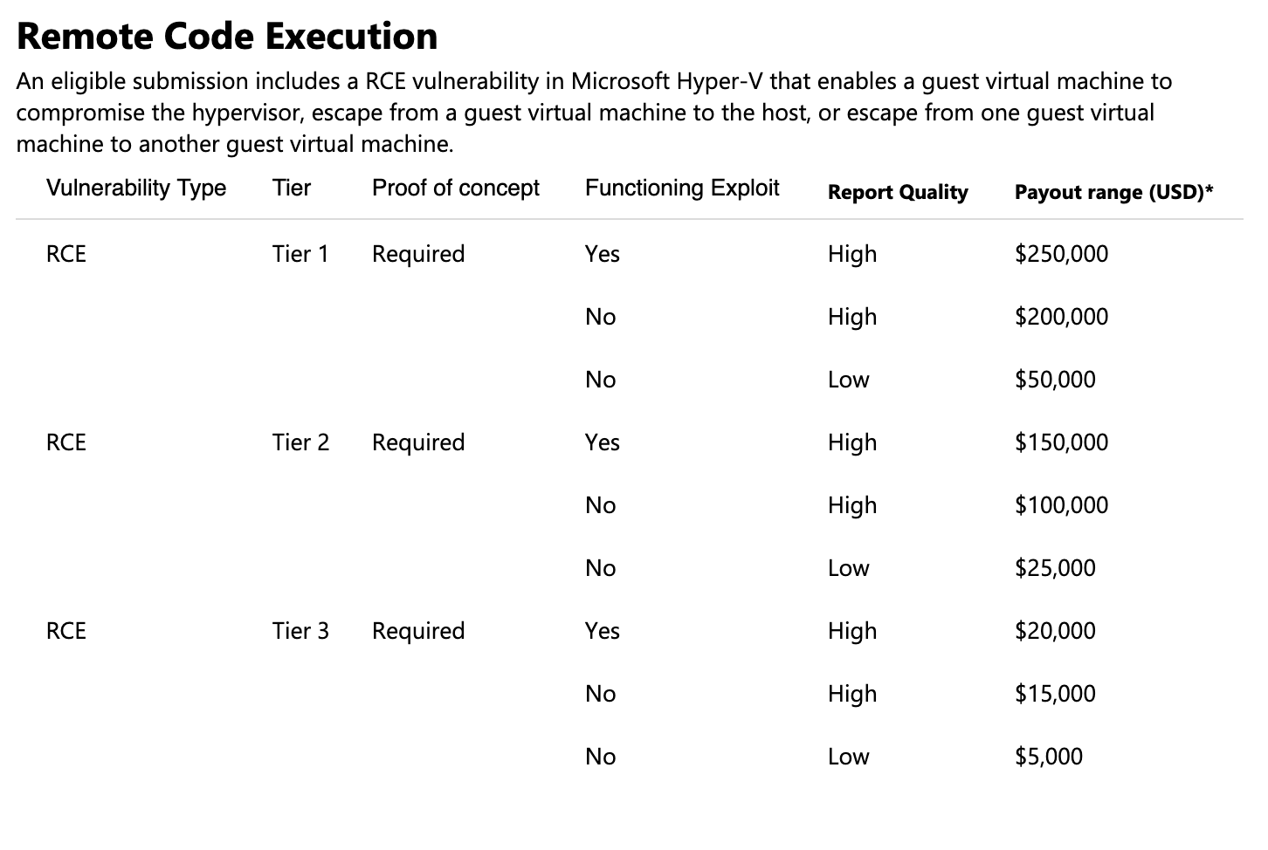


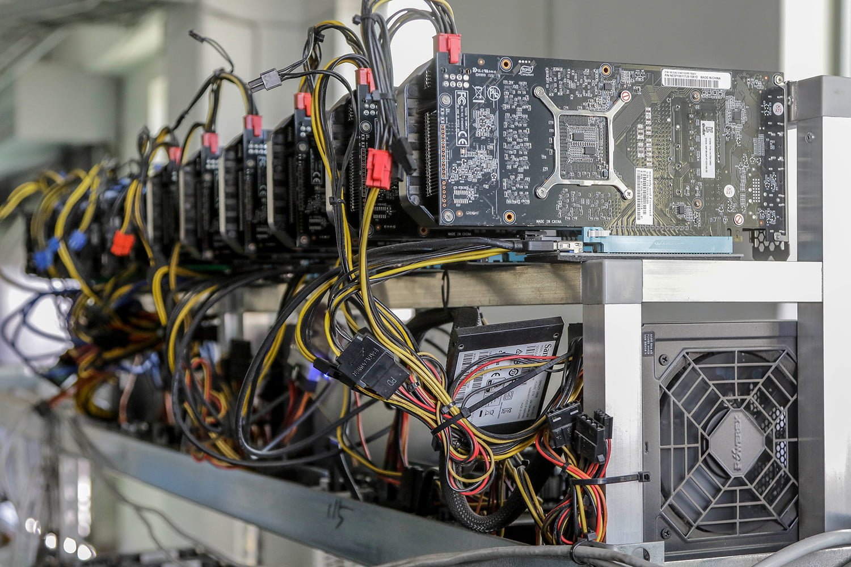
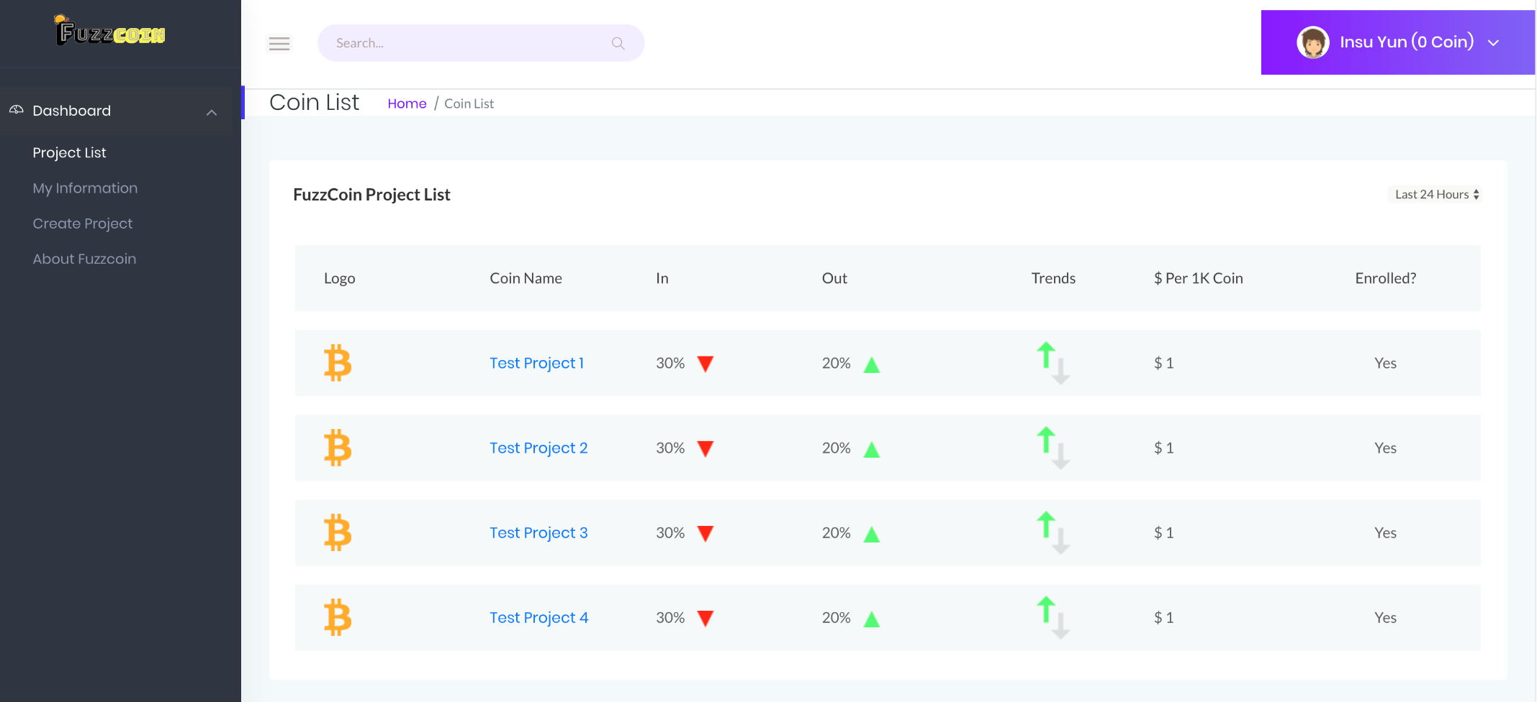
FuzzCoin: Fuzzing as Proof-of-useful-Work for New Virtual Currency
Daehee Jang, Insu Yun, Ammar Askar, Taesoo Kim
A. Motivation
Proof-of-Work: Execution-hashing
Collaboration: Coverage-sharing
Scalability: Aiming at 100K Cores
C. Overview
① Deploy Fuzzer-Container
Software Maintainer
Fuzzing requires massive computing power
(e.g., Google’s Cluster-Fuzz)
Cheat Detection: Use Proof-of-Work, Policy
Deployment: Containerization technique
B. Idea
Untrusted
② Send Proof-of-Work, Bugs
③ Reward
Ecosystem Goal
Put idle computing power to good use (e.g., Search for Extra Terrestrial Intelligence - SETI)
Motivate people to participate on fuzzing project
Achieve large-scale/scalable fuzzing infrastructure
Users (Fuzzing Pool)
Security bugs have economic benefits
D. Usage Model
E. Prototype
② Join the project
FuzzCoin
Main Server
① Open a project using our toolchain
⑥ Claim the reward
and get money
⑤ Request for
giving reward
to the user
People have spare computing power
User
③ Assign work
Software Maintainer
(Server)
④ Send PoW and bugs
Collaborative Fuzzing Ecosystem
for General Public!
Working prototype development in progress
(http://fuzzcoin.kr)
Interaction between three parties
2019 Georgia Institute of Technology

